Slide 1

Diabetes Prediction Using Neural Networks
Elective Course 2 – COMPbb5-3_52_02_2992_20261
Jazan University – College of Engineering and Computer Science
Shahad Ibrahim
202206110
Bushra Salman
202206470
Radhya Hasan
202210255

Slide 2


Project Overview
01
02
Build an ML model to predict whether a patient has diabetes using clinical measurements.
Use the Pima Indians Diabetes dataset (Kaggle/UCI): 8 features → predict Outcome (0/1).
03
04
Implement a feed‑forward neural network (Keras) with standardized inputs.
Evaluate with accuracy, loss curves, and a confusion matrix; report test performance.

Slide 3

Predictive Modeling for Diabetes Risk
A technical brief on training a simple neural network for binary classification of diabetes risk using non-invasive physiological data.
Core Goal
Key Objective
Early identification of diabetes risk from non-invasive clinical measurements.
Train an efficient Neural Network (NN) for high-performance binary classification.
Actionable Insights
Evaluate results using robust metrics and provide practical, data-driven conclusions.

Slide 4
Step 1: Problem Framing and Input Data
We utilized the Pima Indians Diabetes Dataset, focusing on a set of non-invasive measurements as input features and predicting a binary outcome.
Input Features (X)
1
2
Physiological Data
Metabolic Indicators
Pregnancies, BloodPressure, SkinThickness, Insulin, BMI (Body Mass Index).
Glucose Concentration (plasma), DiabetesPedigreeFunction (genetic risk score).
3
4
Demographic
Outcome
Age of the patient.
1 = Diabetic
0 = Non-Diabetic

Slide 5



Step 1: Defining the Prediction Task
Prediction Task: Binary Classification
The model's goal is to predict one of two mutually exclusive classes: diabetic or non-diabetic.
Why Binary Classification?
What it is NOT
The target variable (Outcome) has exactly two possible categories.
Not Multi-class (more than two distinct outcomes).
Requires a Sigmoid activation function on the final output layer.
Not Regression (predicting a continuous value).
The appropriate loss function is Binary Crossentropy.
Not Clustering (unsupervised grouping).

Slide 6

Dataset Summary: Pima Indians Diabetes Dataset
Dataset & Source
1
A standard benchmark dataset often used for introductory machine learning classification tasks.
Source: Kaggle / UCI Machine Learning Repository.
2
Data Volume & Structure
A total of 768 records available, each featuring 8 continuous/numeric input features and 1 binary output label.
3
Class Balance
The dataset is mildly imbalanced (approx. 65% non-diabetic, 35% diabetic). This necessitates careful metric selection (beyond simple accuracy).
4
Train/Test Split
A stratified 80% Train / 20% Test split was applied (using random_state=42) to ensure both sets maintain the original class proportion.

Slide 7




Critical Step: Data Preparation and Preprocessing
To ensure robust model training and prevent feature dominance due to scale differences, standardization was essential.
Feature/Label Segregation
X assigned to the 8 input features; y assigned to the binary Outcome label.
Data Standardization
Applied StandardScaler() to normalize all features, ensuring mean = 0 and standard deviation = 1 across the training set.
The scaler was fit only on the training data, then used to transform both train and test sets.
Internal Validation Split
A 20% validation split was dynamically reserved from the training data during the model.fit() process for monitoring loss and preventing overfitting during training.

Slide 8

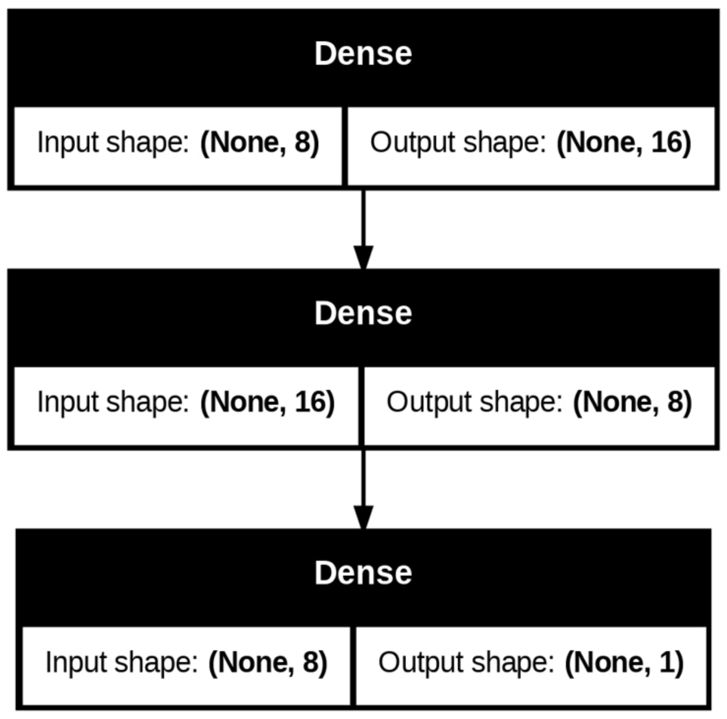

Model Architecture
(Keras Sequential)
Input: shape = (8).
Hidden Layer 1: Dense(16), activation = ReLU.
Hidden Layer 2: Dense(8), activation = ReLU.
Output: Dense(1), activation = Sigmoid (probability of diabetes).
Model summary: Provided in notebook; includes parameter counts.

Slide 9


Model Configuration: Loss Function & Optimizer
Loss Function: Binary Crossentropy
Optimizer: Adam
Measures the performance of a classification model whose output is a probability value between 0 and 1.
Chosen for its efficiency and adaptability. Adam combines the benefits of both AdaGrad and RMSProp, maintaining per-parameter learning rates.
It penalizes divergence from the true binary labels (0 or 1), making it ideal for our task.
It is a robust and strong default choice for deep learning classification problems.
The primary metric monitored during the training loop was Accuracy to track the proportion of correct predictions.

Slide 10


Hyperparameters and Training Process
50
16
0.2
Epochs
Batch Size
Validation Split
Total passes over the entire training dataset. Balanced to ensure convergence without excessive training time.
Number of samples processed before the model's internal parameters are updated.
Fraction of the training data used for internal validation, providing an early gauge of generalization.
Note on Advanced Techniques
Callbacks such as EarlyStopping and LearningRateScheduler were intentionally omitted for this initial simple model.

Slide 11

Evaluation Strategy: The Hold-Out Test Set
Final model performance was assessed exclusively on the 20% hold-out test set, ensuring an unbiased measure of generalization.
Test Set Integrity
1
The 20% hold-out was never seen during training and was standardized using the scaler fitted on the training data.
Key Reported Metrics
2
Primary measures: Test Accuracy (≈ 0.82) and Test Loss (Binary Crossentropy value).
Diagnostic Tools
3
A detailed Confusion Matrix was generated to visualize prediction outcomes, including False Positives (FP) and False Negatives (FN).

Slide 12

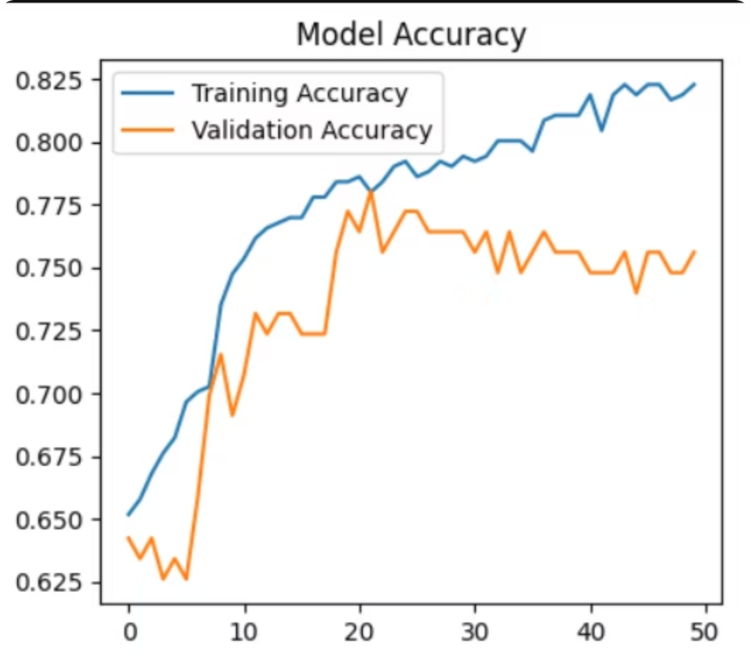
Results: Learning Curves
(Training vs Validation)
Observation: Both trends improve and stabilize; limited overfitting.

Slide 13

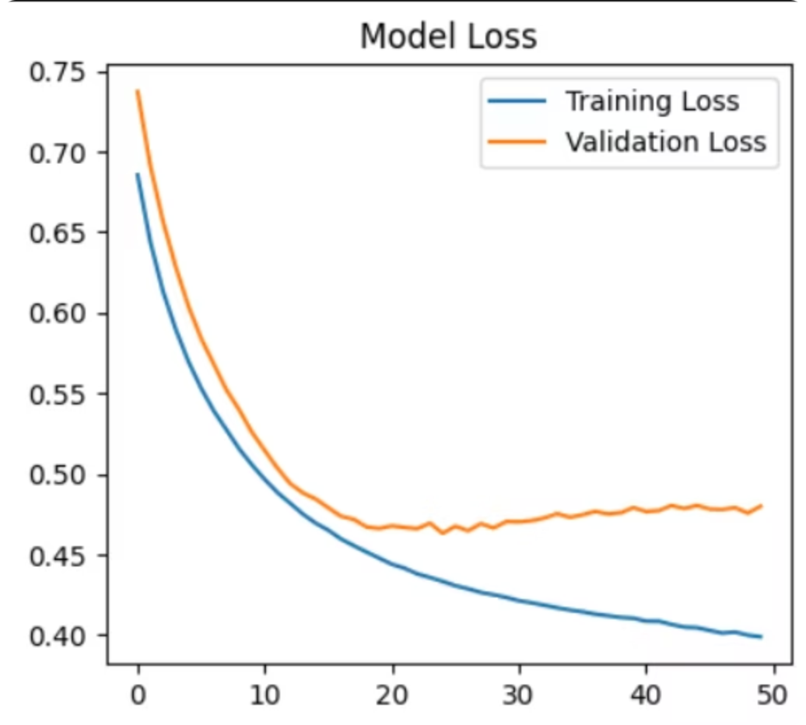
Results: Learning Curves
(Training vs Validation)
Observation: Training and validation loss decrease; convergence achieved.

Slide 14

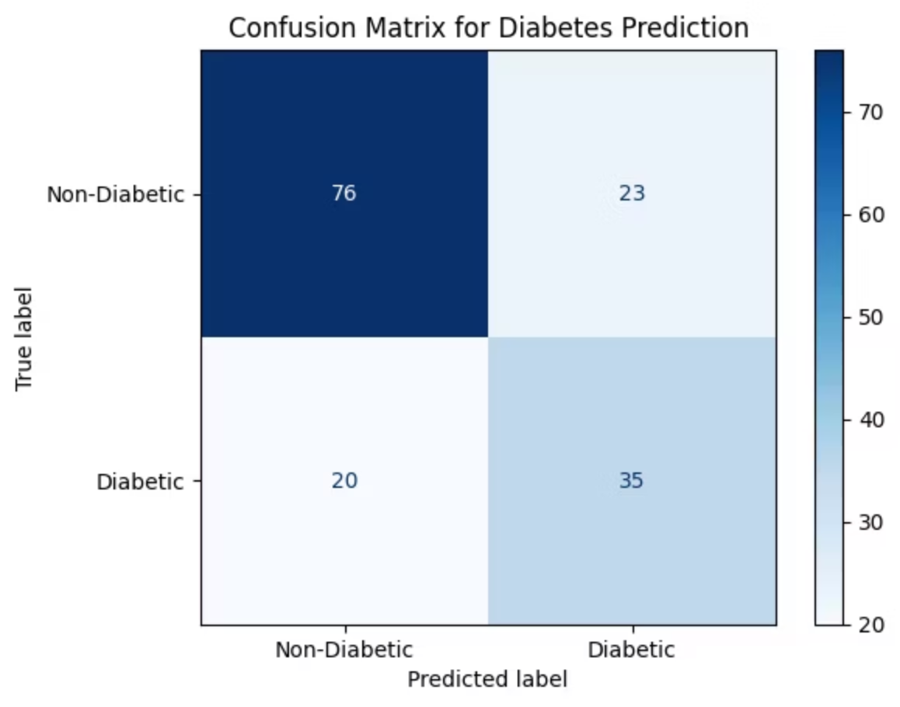



Results: Performance Metrics & Diagnostics
82%
18%
1/3
Test Accuracy
Overall Error Rate
Diabetic Class Proportion
Confusion Matrix for Diabetes Prediction
Interpretation: The model demonstrated balanced performance. The presence of False Negatives (actual diabetic patients predicted non-diabetic) suggests potential trade-offs. Future work should focus on threshold tuning to optimize the critical metrics of Sensitivity (Recall) and Specificity.

Slide 15
Conclusions and Future Work Roadmap
Successful Classification
Key Learning: Preprocessing
We successfully built a small NN that achieved approximately 82% test accuracy for diabetes risk prediction, validating the architecture.
Feature standardization was critical for training stability. Evaluation metrics beyond accuracy (e.g., Confusion Matrix analysis) are vital, especially in medical contexts.
Roadmap: Enhancing Model Robustness
Data Cleanup
Model Expansion
Address zero values in columns like Blood Pressure or BMI, which often represent missing data.
Explore alternative classifiers (Logistic Regression, XGBoost) and add regularization to the current NN.
Imbalance Handling
Clinical Calibration
Implement techniques (e.g., SMOTE, class weighting) to mitigate the dataset's mild class imbalance.
Calibrate prediction probabilities to establish reliable clinical decision thresholds that manage risk trade-offs.

Slide 16
Thank You!

